Slide 1
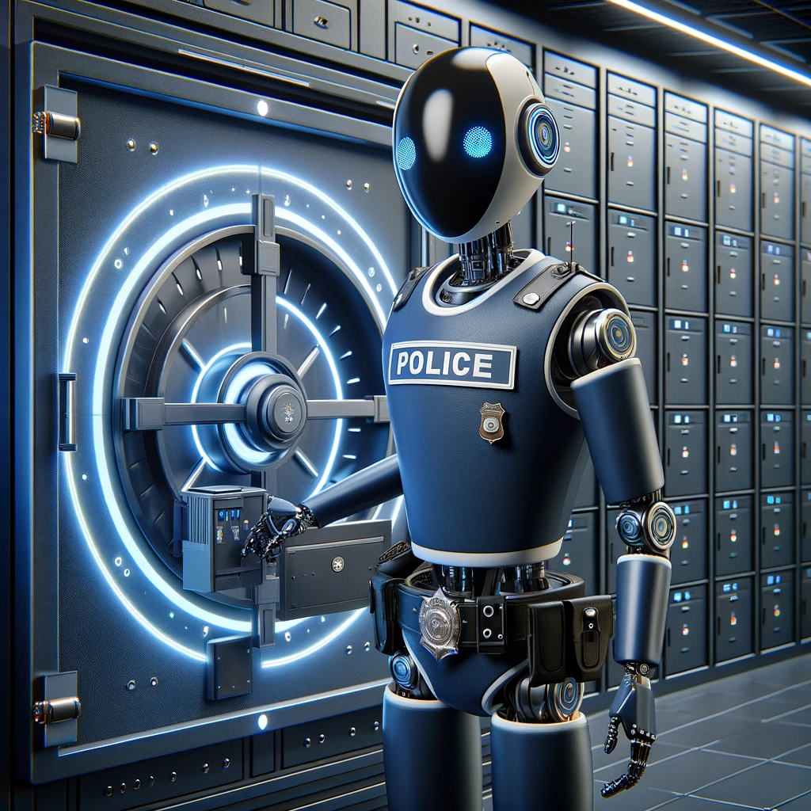
AI Security

Slide 2
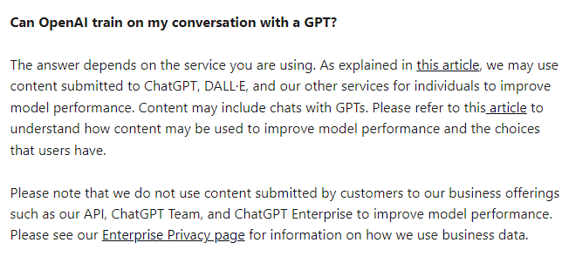
Notes:
https://help.openai.com/en/articles/8554402-gpts-data-privacy-faqs

Slide 3
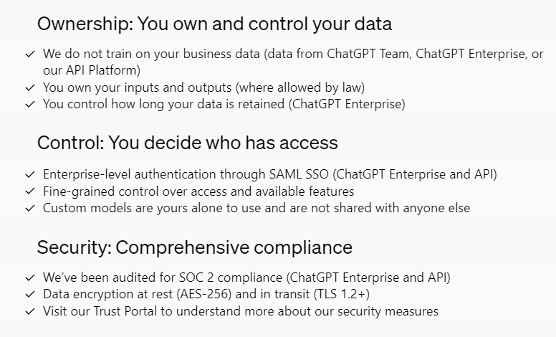
Notes:
https://openai.com/enterprise-privacy

Slide 4
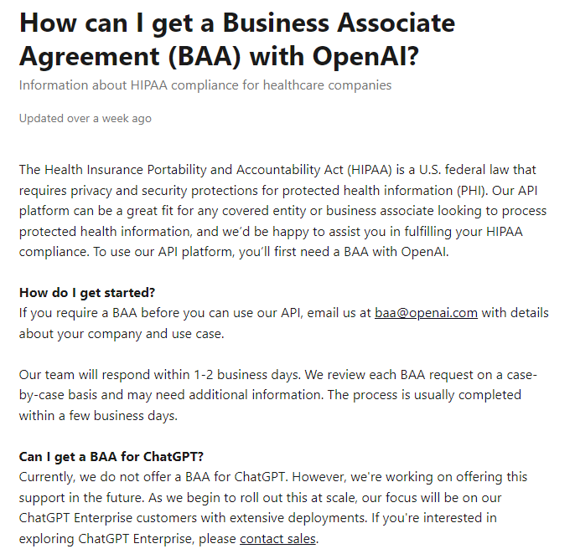
Notes:
https://help.openai.com/en/articles/8660679-how-can-i-get-a-business-associate-agreement-baa-with-openai

Slide 5
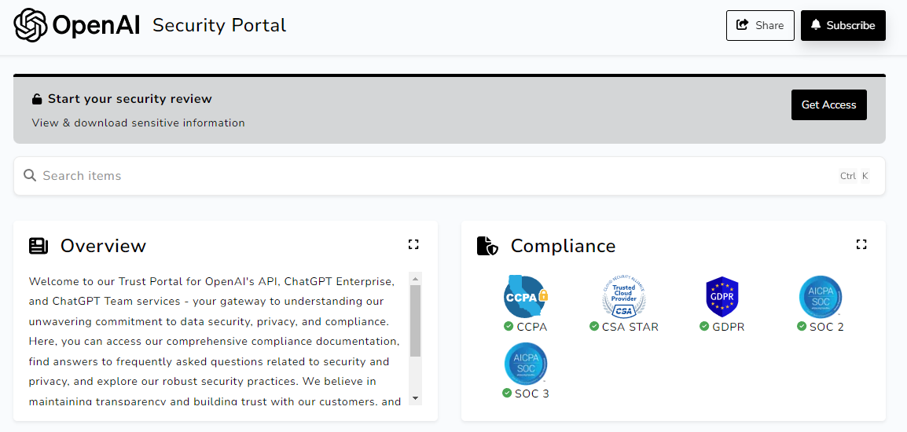
Notes:
https://trust.openai.com/

Slide 6

AI at work

Slide 7
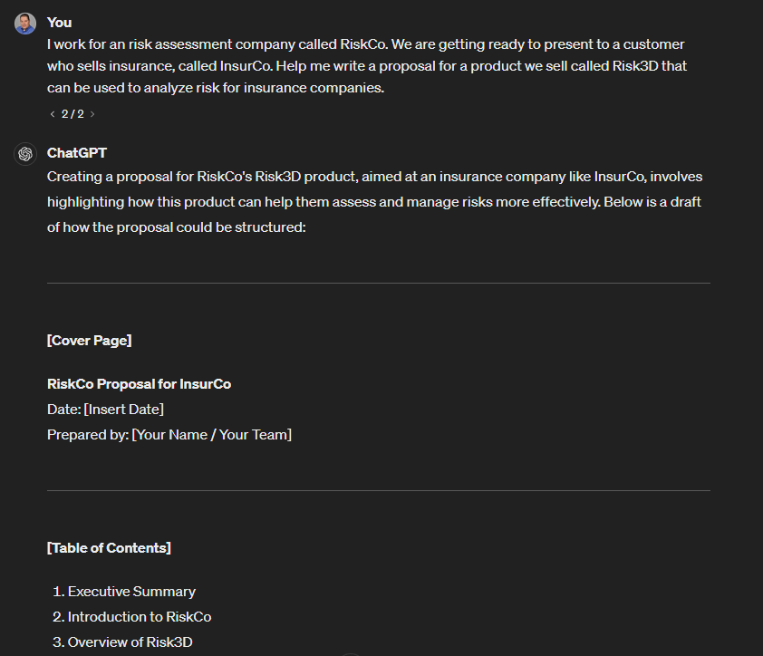
sales

Slide 8
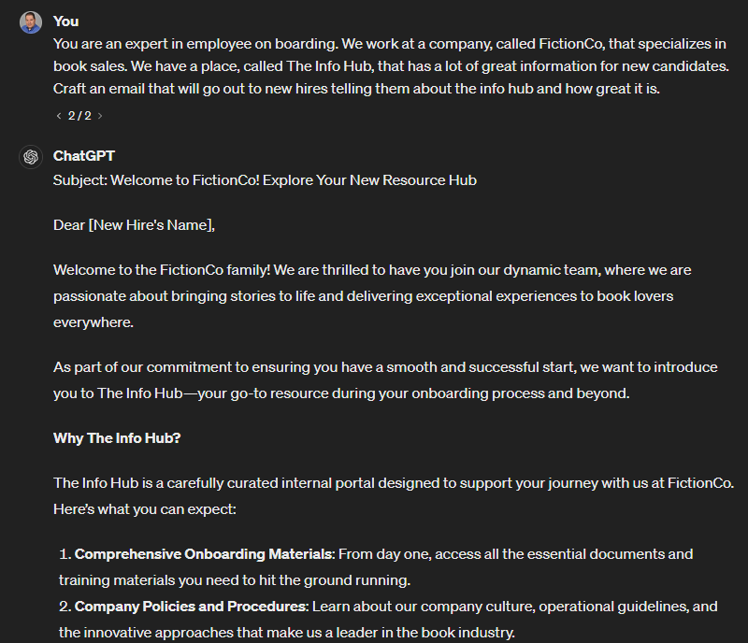
Human resources

Slide 9
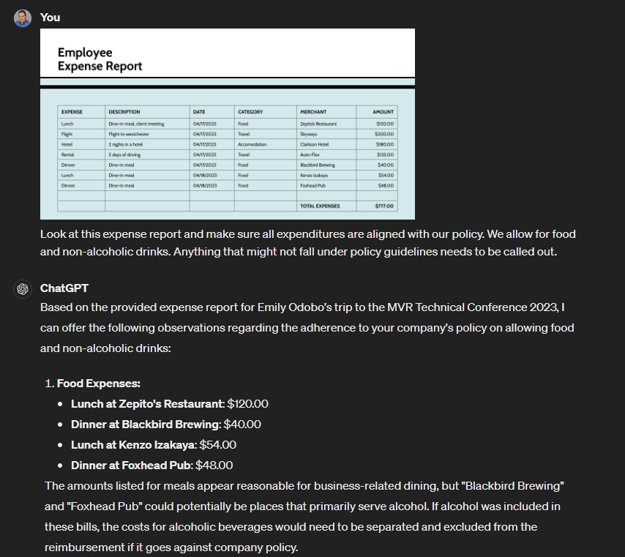
Finance

Slide 10
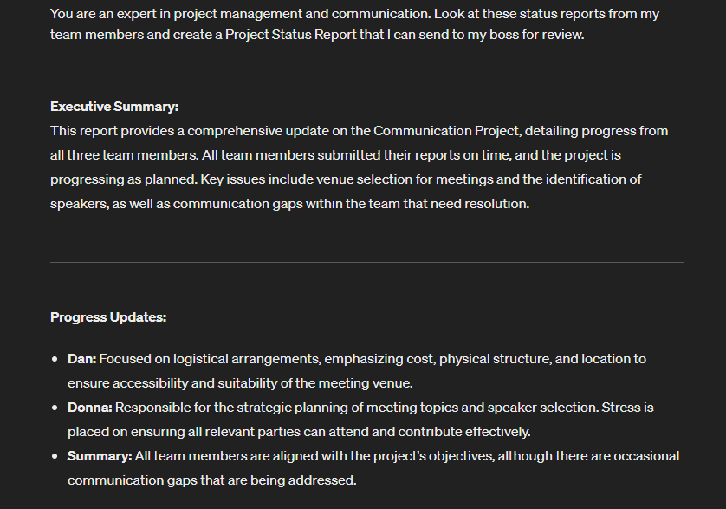
Project Management

Slide 11
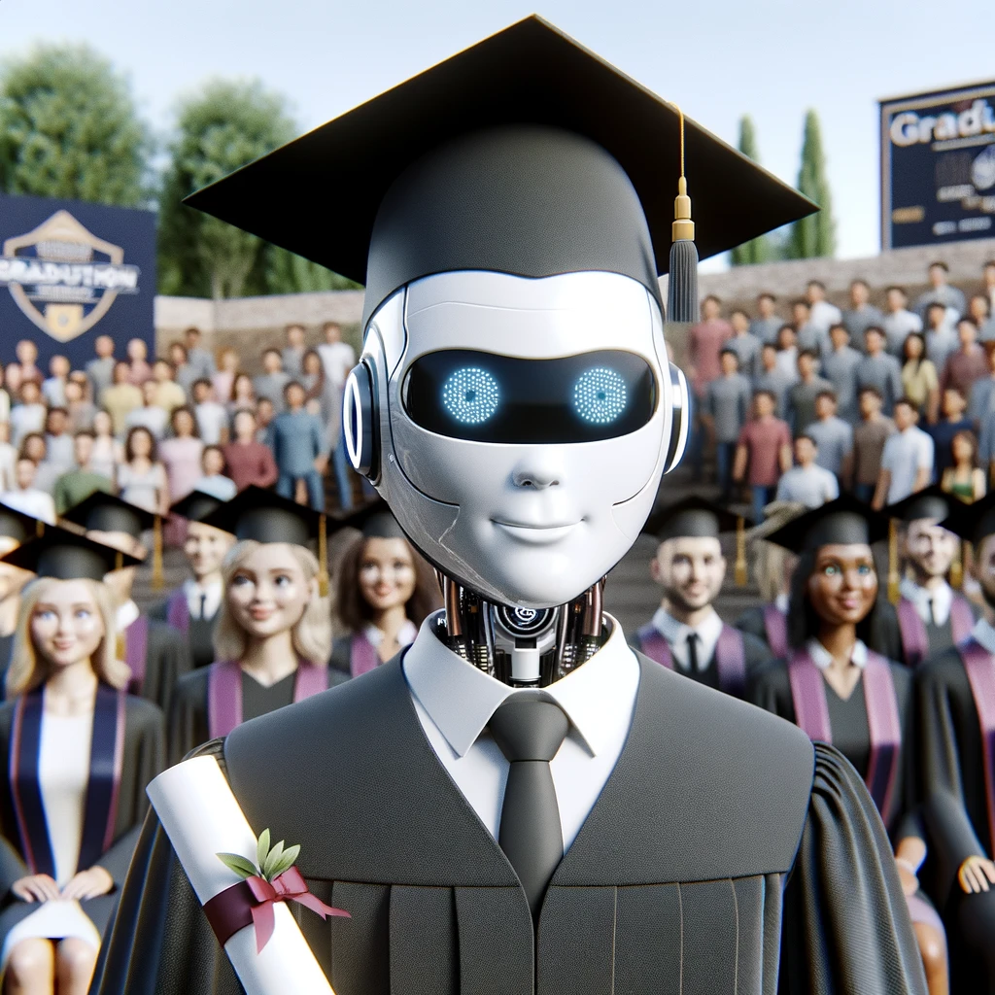
ChatGPT is very smart

Slide 12
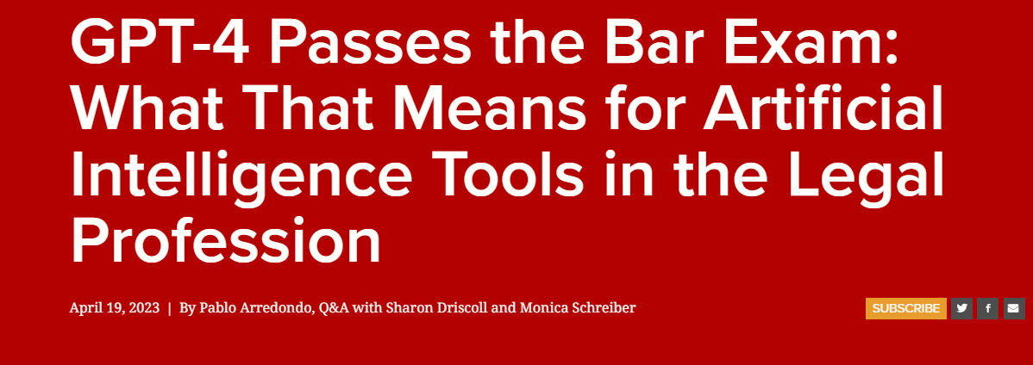
Notes:
https://law.stanford.edu/2023/04/19/gpt-4-passes-the-bar-exam-what-that-means-for-artificial-intelligence-tools-in-the-legal-industry/

Slide 13
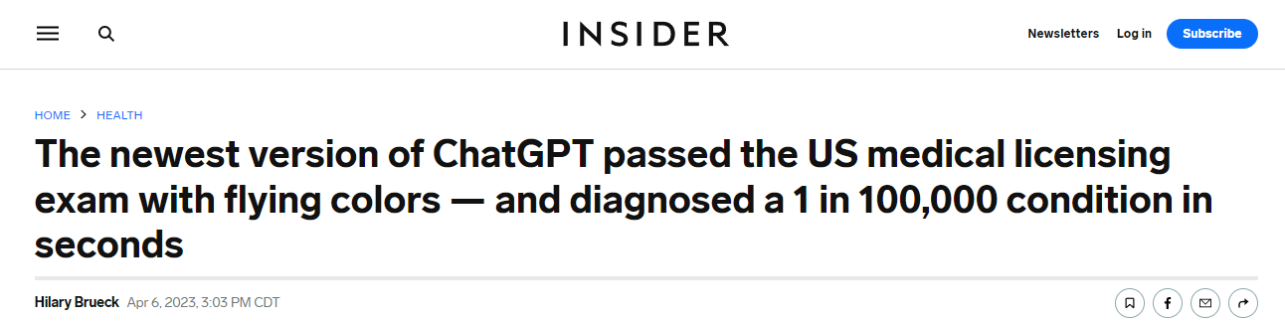
Notes:
https://www.insider.com/chatgpt-passes-medical-exam-diagnoses-rare-condition-2023-4

Slide 14
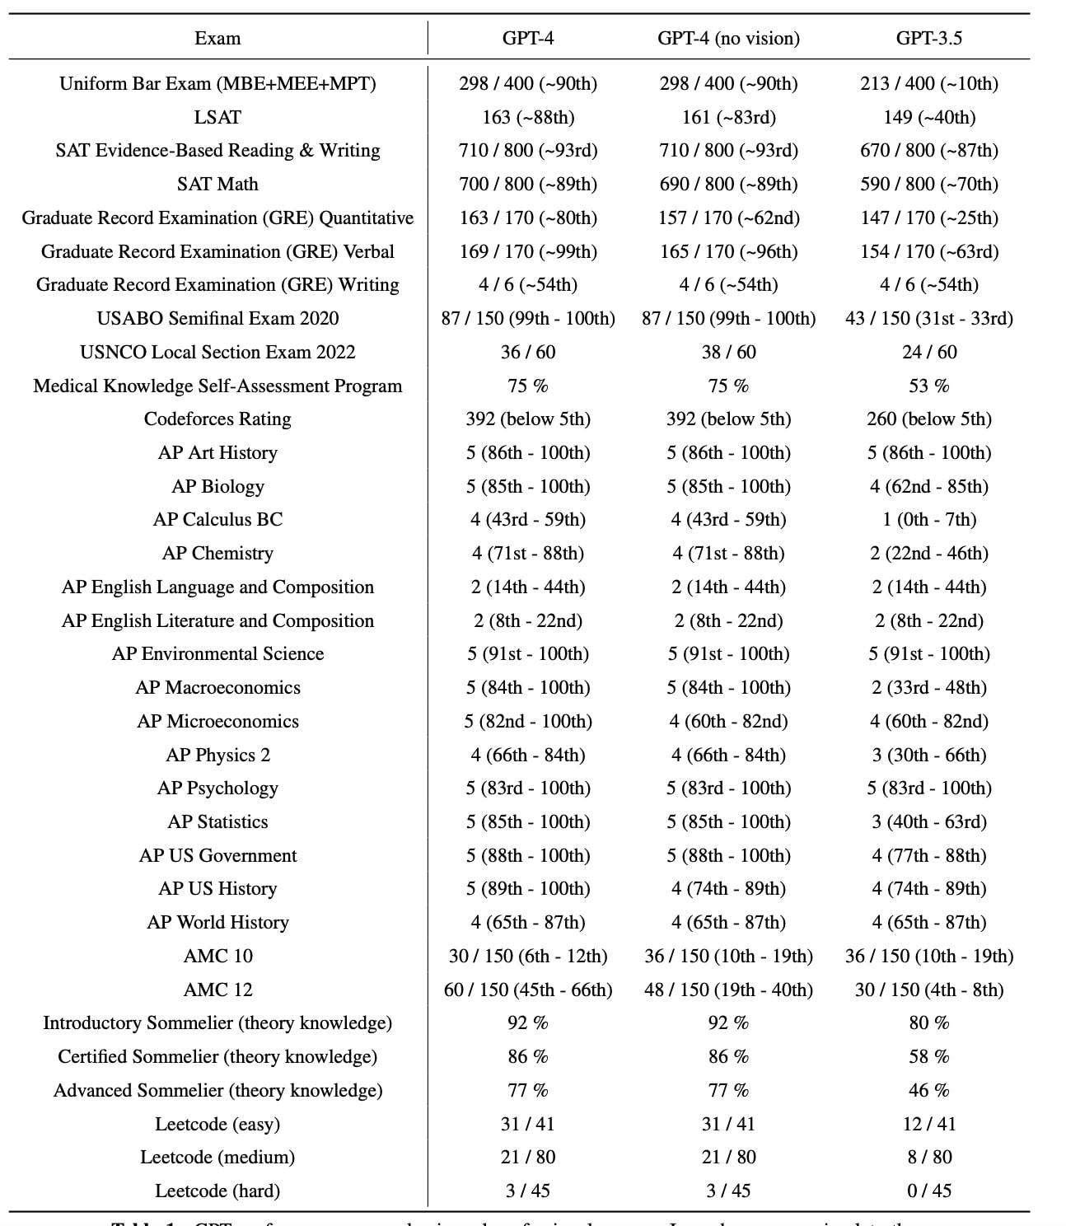

Slide 15
